Slide 1
PSYC 121, Week 2
Hello again!

Slide 2
Module exercises and activities
Last week:
Rolling dice (why?)
Starting up RStudio
Teaching data survey
Support signposts
Video resources (within the lab handbook)
David Howell book
Prep
Complete lab prep (learnr tutorial) – should be available Monday p.m.
This week
Working with files
basic descriptive statistics in R
plots of distributions

Slide 3
Wisdom from a student who was in your shoes as a first year learning R
“I think my advice for r when starting out is to keep your files organised, save your scripts, and label all your chunks of code so that you start building a foundation of scripts you can dip in and out of when you are stuck”

Slide 4
Measures of central tendency (CT)
mean, median, mode
some CT measures are influenced by outliers more than others
in symmetrical distributions (i.e., normal) the 3 measures are all the same
in skewed distributions, the 3 CTs are not the same but have a definite order
Notes:
Briefly define the different types of CT (we cover this in the lecture so no need to go into too much detail)
Those influenced more by outliers: mean and to a lesser extent the median
Skewed distributions:
Negatively skewed: mean < median < mode
Positively skewed: mode < median < mean

Slide 5
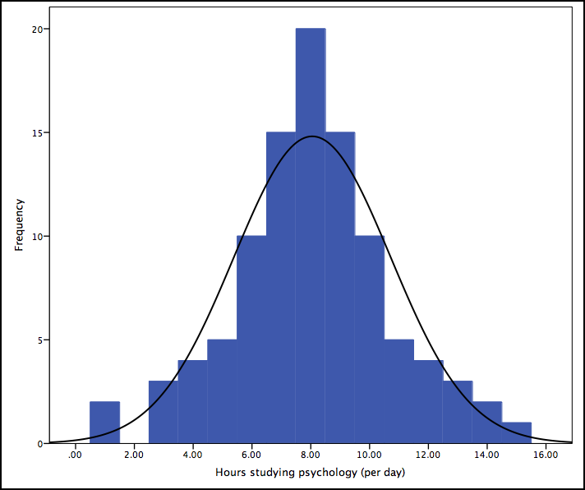
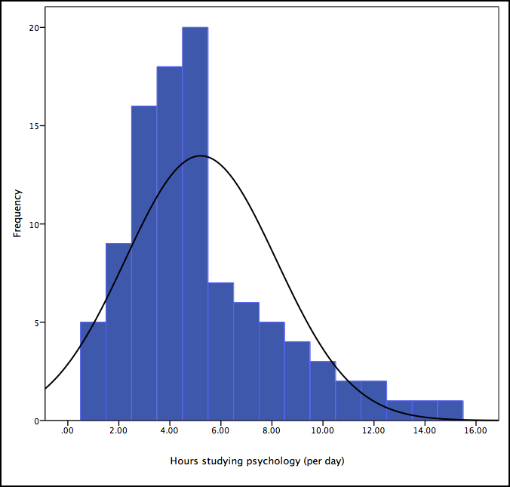
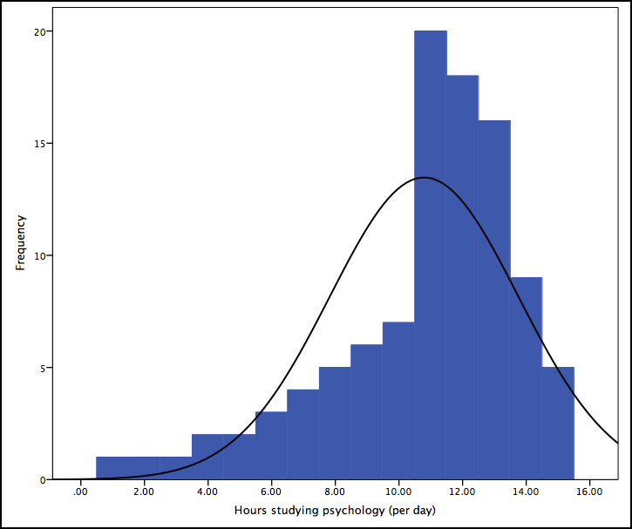
measures of central tendency (CT)
Mean
Mode
Median
Mode
Mean
Median
Median
Mean
Mode
Notes:
Briefly define the different types of CT (we cover this in the lecture so no need to go into too much detail)
Those influenced more by outliers: mean and to a lesser extent the median. Essentially the mean gets pulled into the tail of the distribution.
Example figures are given. In distributions with a bigger range (this one only goes from 1-15) you’re likely to see a bigger spacing between the three measures. That is, the mean will be a lot higher/smaller than the other two measures of CT
Skewed distributions:
Negatively skewed: mean < median < mode
Positively skewed: mode < median < mean

Slide 6
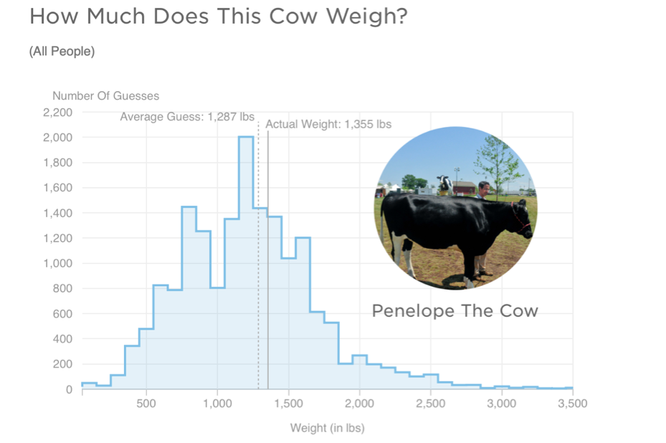
From ideal data to more real data

Slide 7
Lab tasks
Load in the specific week 2 teaching dataset from the “week_2.zip” file
Answer the labsheet questions
Check your answers if you are not sure

Slide 8
Why spend time on graphs in PSYC121?
(A) Understanding variability (see analysis lecture)
(B) So as to avoid ‘graph crimes’ …

Slide 9
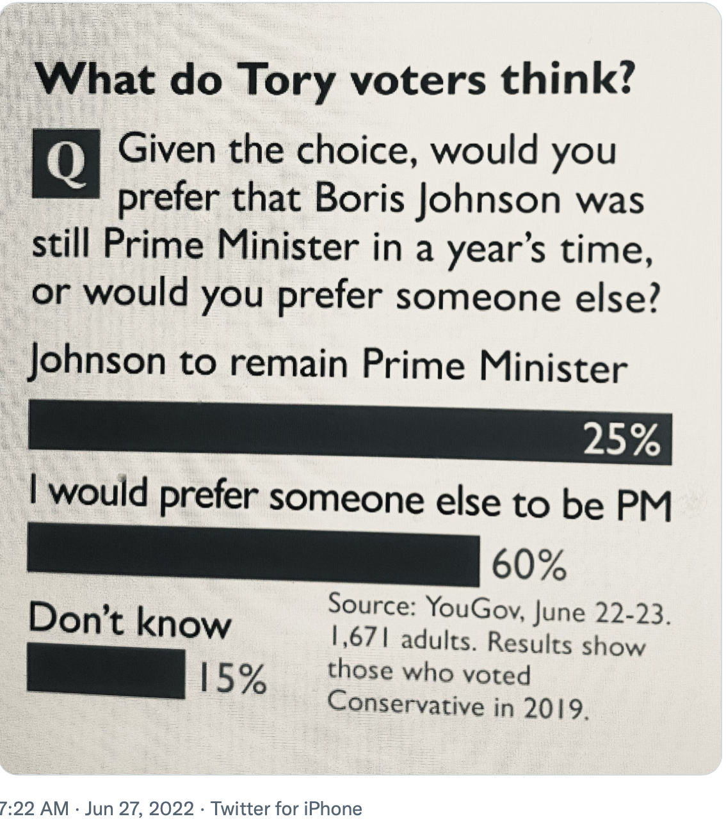
Exhibit A (The Times)

Slide 10
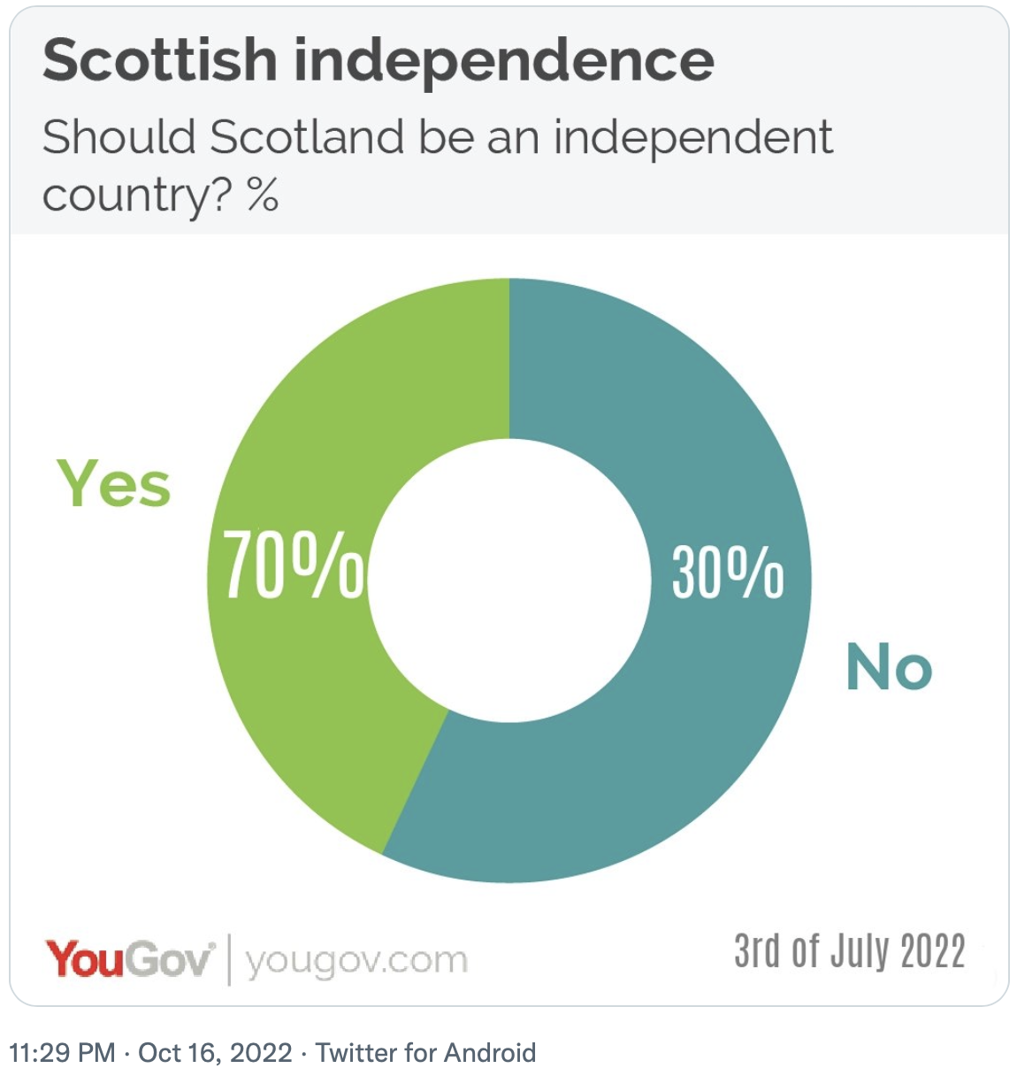
Exhibit B

Slide 12
Task 1
What is the mean weight guess among the PSYC121 students?
736 lbs (735.9681)
What is the standard deviation of the guess?
440 (440.2) lbs
What is the median weight guess among PSYC121 students?
550 lbs
Which of these central tendency measures is the more accurate measure of the true cow weight?
Mean is more accurate than median (closer to actual weight)
What is the mean weight guess (and standard deviation) for female respondents and non-female (male and non-binary) respondents?
M= 703 (sd=413) lbs,;for other group, 891 (sd=533) lbs

